Slide 1

Sizewell C / Yoxford Parish Council update
Wednesday 20 November 2024

Slide 2
Agenda​
​
Introductions​
Northern Park and Ride​
Site Delivery Lookahead​
Design Status​
Yoxford Roundabout ​
Sizewell Link Road​
Local Road Improvement Schemes ​
Average Speed Camera ​
Q&A
Close 8pm

Slide 3
Introductions
Marjorie Barnes – Head of Regional External Affairs and Development (READ) Team
Richard Knight – Senior Community Relations Manager
Zoe Botten – Community Relations Manager
Paul Tweddle – Off Site Infrastructure Team
John Craddock – Senior Project Manager: Highways
Jez Porter – Stakeholder and External Roads lead
Rebecca Quigg – SZC Transport Coordinator

Slide 4
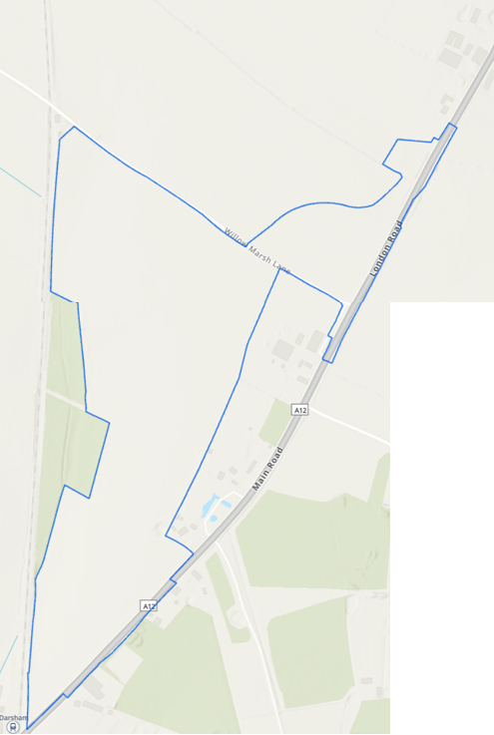
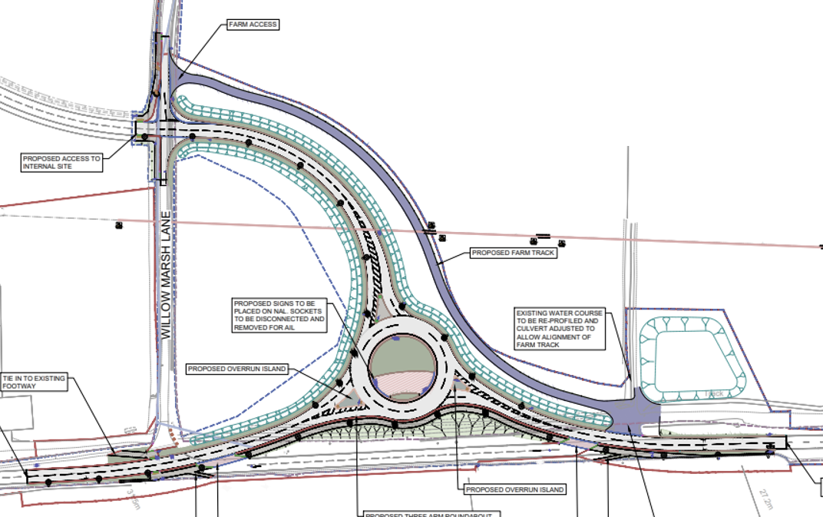
Northern Park and Ride Early Works Q4 24/Q1 25
Q4-24 (Completed)
Vegetation Clearance (Willow March Lane)
Q4-24 (Planned)
Design submitted to SCC and ESC
Finalise contractor selection
Q1-25:
Temporary site Access from Willow March lane
Archaeology (ca. 3-months)
Contractor mobilisation (Q1-25)
Q2-25 onwards:
Roundabout works (Q2-25)
Main Works (Q2-25 till Q3-26)
Vegetation Clearance (along A12 – roundabout tie-in points – Q2 25)
NOT PROTECTIVELY MARKED | © 2023 Sizewell C Limited. All rights Reserved.
Archaeology
Vegetation Clearance
4

Slide 5
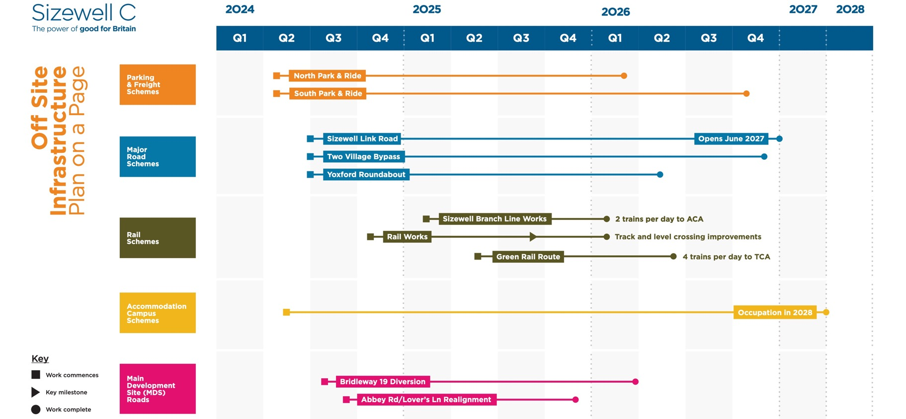
Site Delivery Lookahead – Yoxford Roundabout
1
2
3
4
5
6
7
8
9
10

Slide 6
Design Status and Activity in Next Six Months
  Design:
    SCC have granted Technical Approval for the highway elements of the scheme
    Landscaping has been submitted to ESC for approval – review completes mid-December
  Procurement:
    Tenders received and tender assessment is in progress
    Contract award in December 24 / January 2025
    Start on Site in Q1 2025 – date TBD
    Utility works:
    BT Openreach – undergrounding of cables and pole removal on B1122 (SoS: Jan 25)
    Essex & Suffolk Water – approx. 2 months work (SoS late Jan 25 / early Feb 25)
    Coordination
    Final vegetation clearance within margin of the water course
    Alignment with the Yoxford signalised crossing programme
    Traffic Management plans to be coordinated and agreed with SCC and contractor(s)
    Work coordination with North Park & Ride construction sequence
6

Slide 7
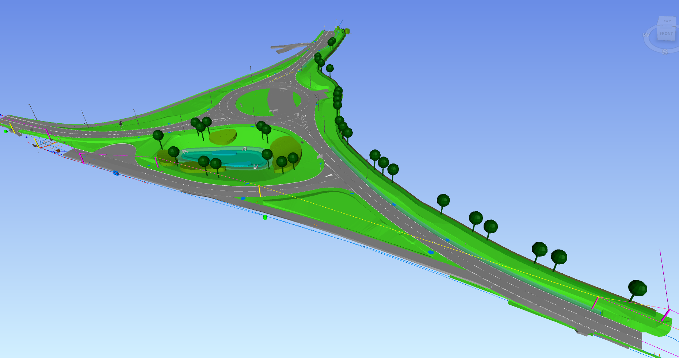
Yoxford Roundabout
NOT PROTECTIVELY MARKED | © 2023 Sizewell C Limited. All rights Reserved.
7

Slide 8
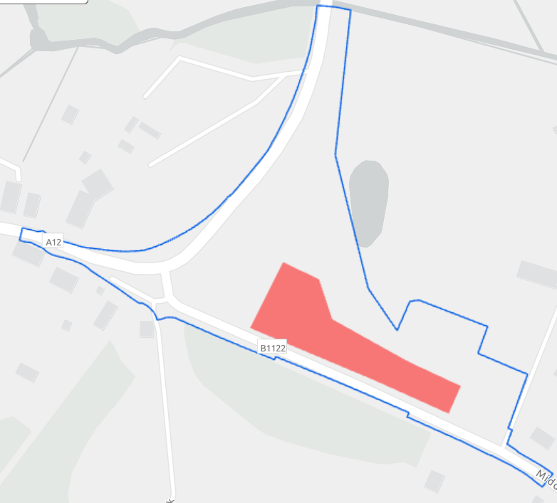
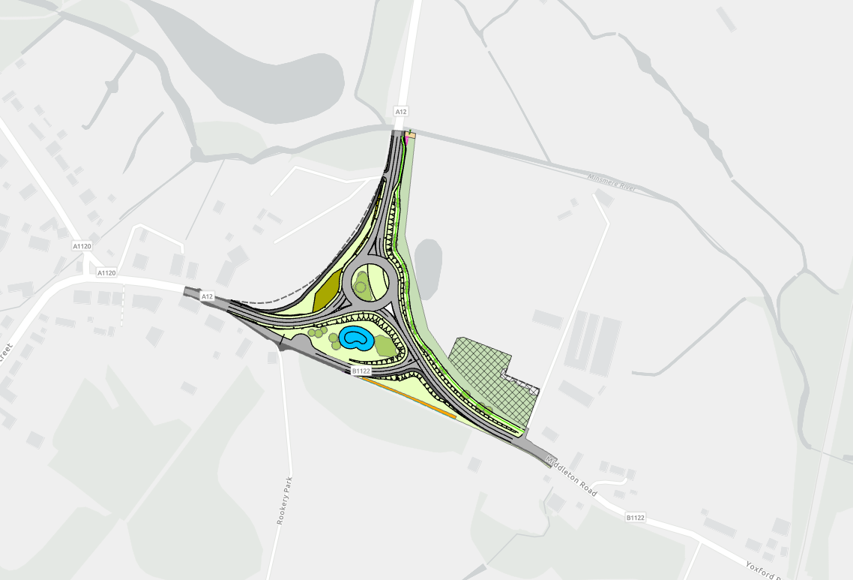
Yoxford Roundabout Early Works Q4 24/Q1 25
Pre-Construction Activities at Yoxford Roundabout
Middleton Moor Spur: • Vegetation Management • Archaeology Mitigation • Site Security & Fencing
NOT PROTECTIVELY MARKED | © 2023 Sizewell C Limited. All rights Reserved.
Compound
Archaeology
Vegetation Clearance
Utilities
8

Slide 9
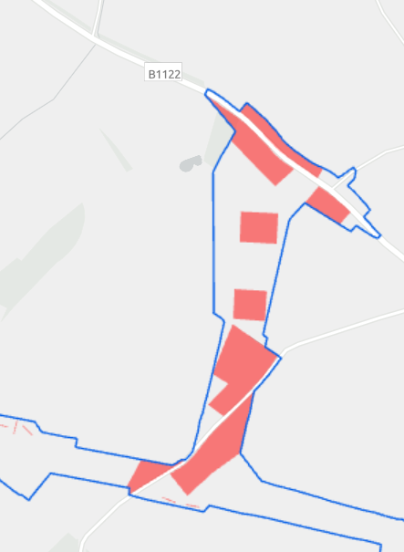
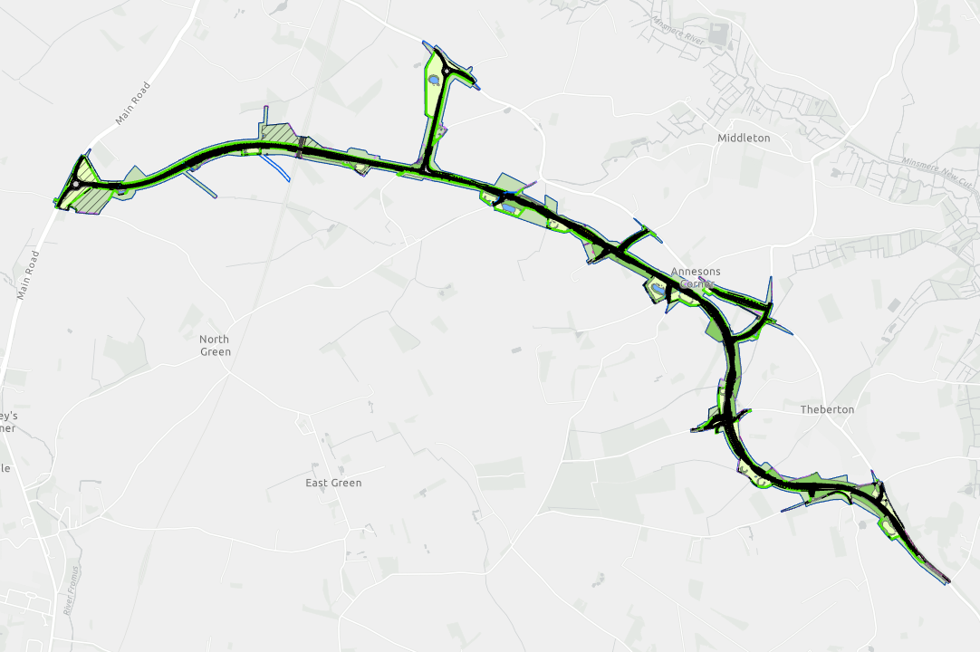
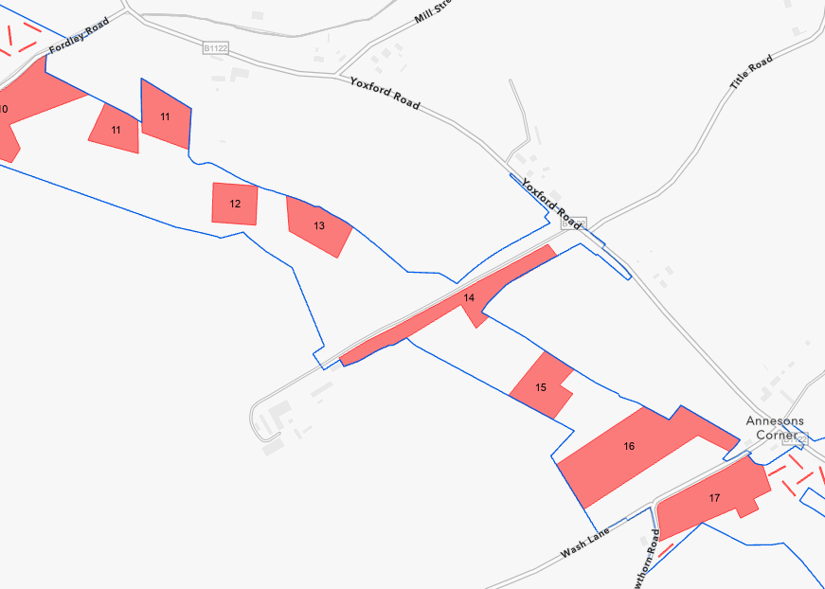
Sizewell Link Road (SLR) Early Works Q4 24/Q1 25
Pre-Construction Activities at Sizewell Link Road
Middleton Moor Spur: • Vegetation Management • Archaeology Mitigation • Site Security & Fencing
Archaeology
Vegetation Clearance
Compounds
9

Slide 10
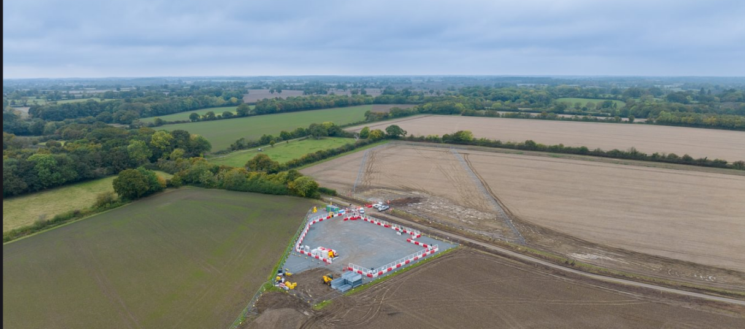
SLR - site compound on Littlemoor Road Phase 1

Slide 11
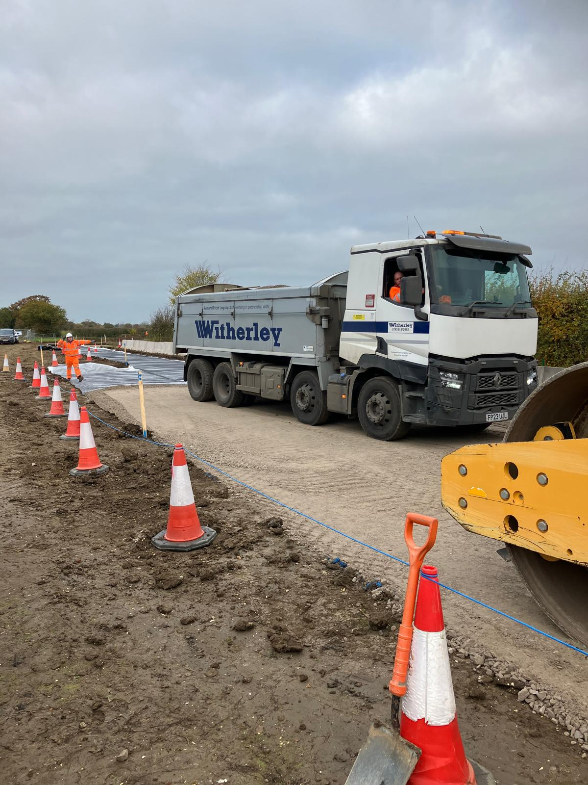
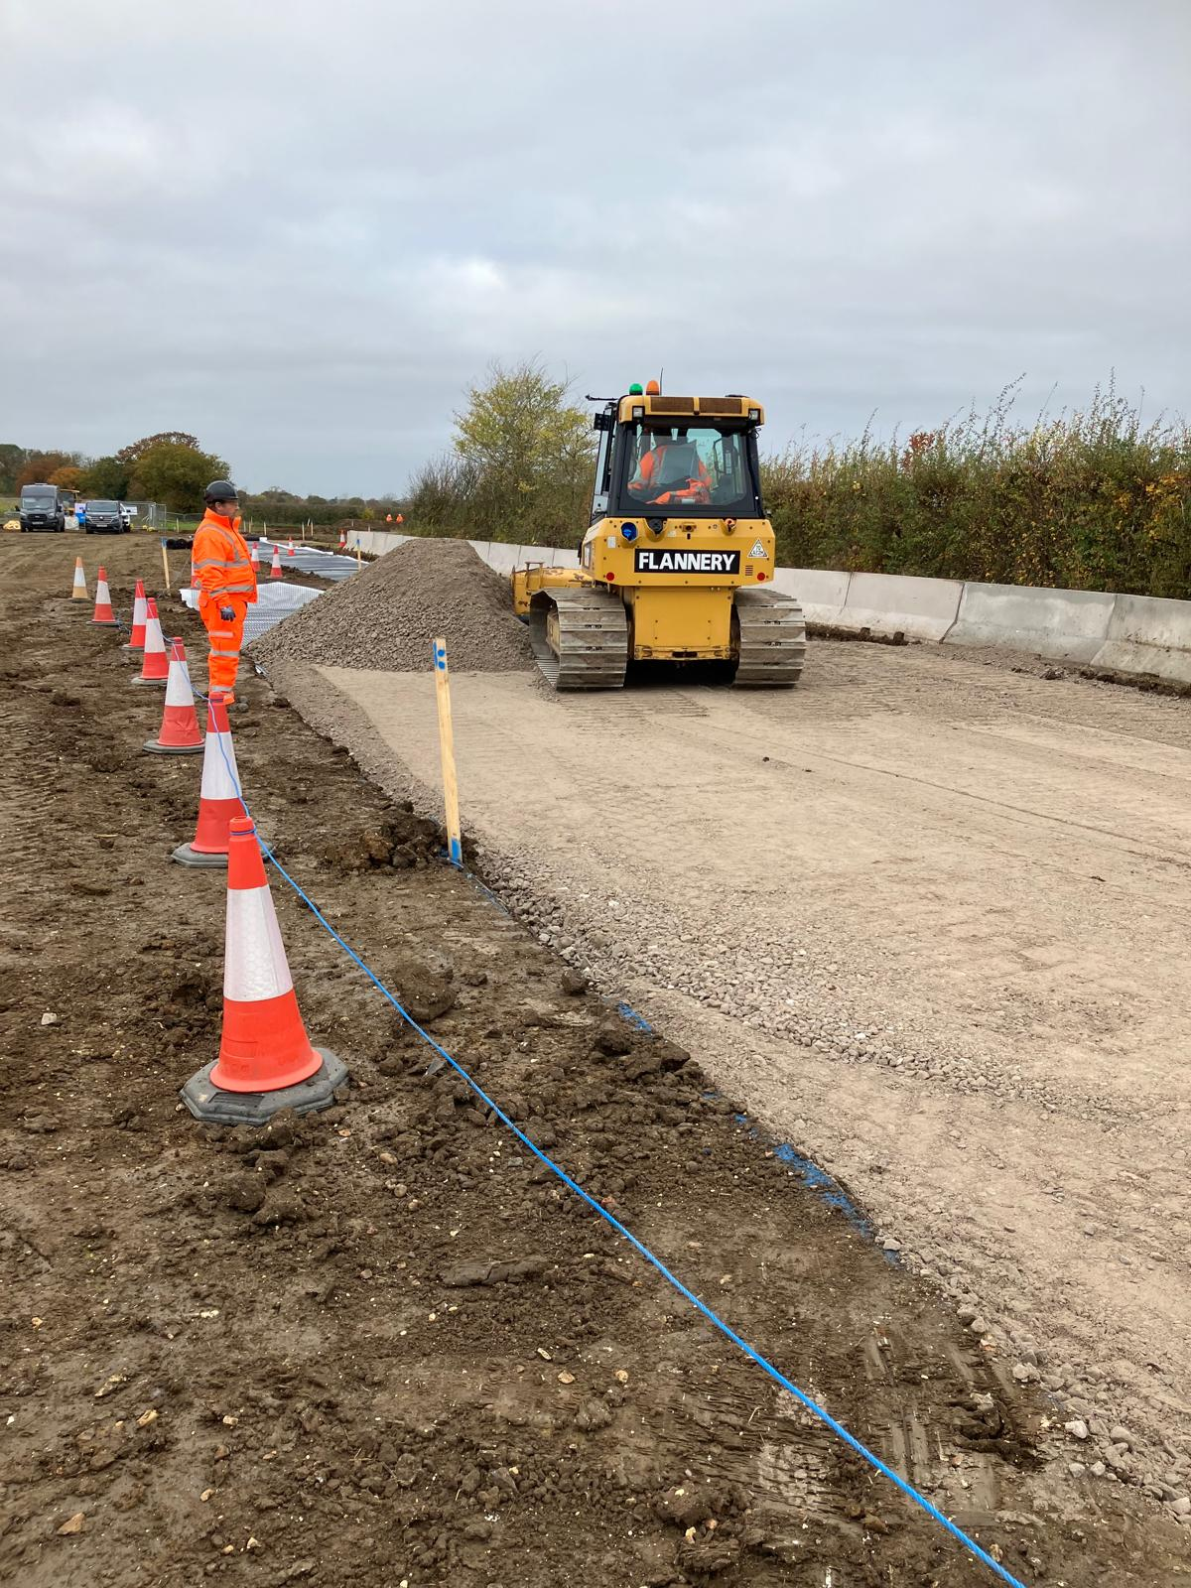
SLR - Compound started at Littlemoor Road Phase 2
Note: Work has just commenced, compound will be finished to same high standard as that at Littlemoor Road Phase 1

Slide 12
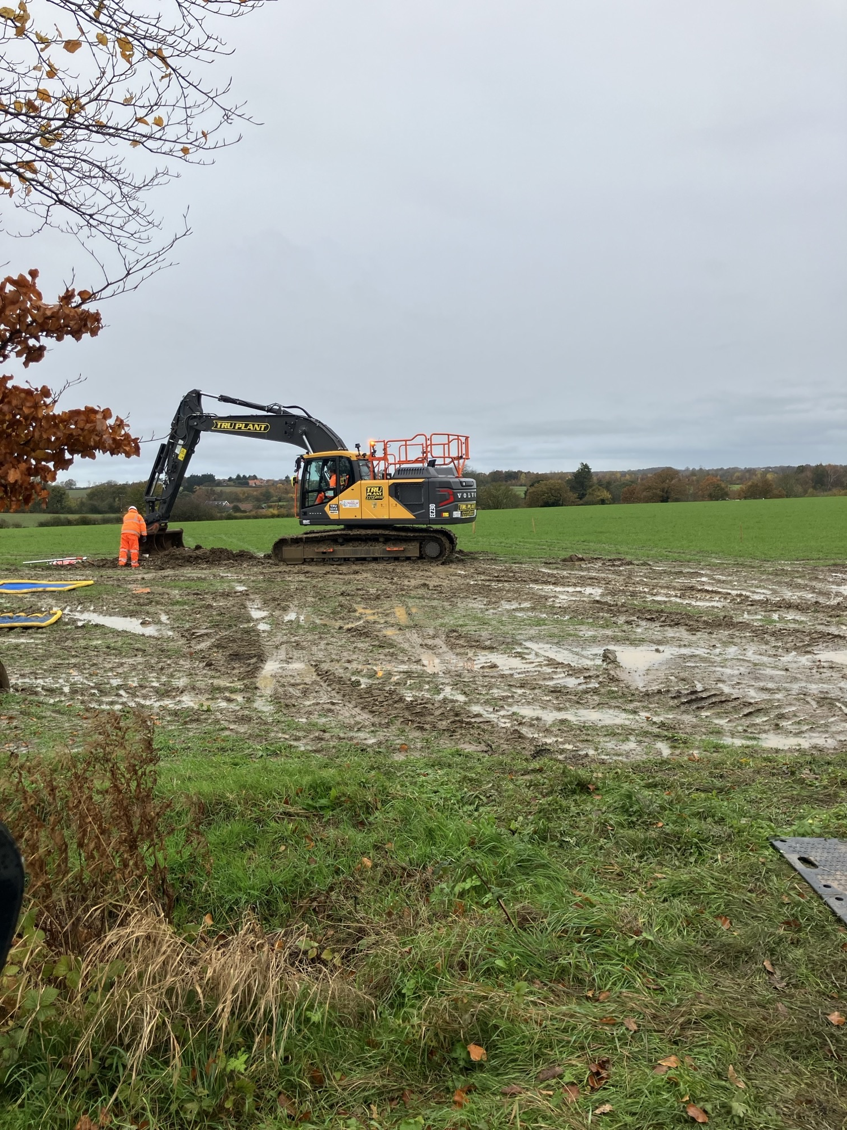
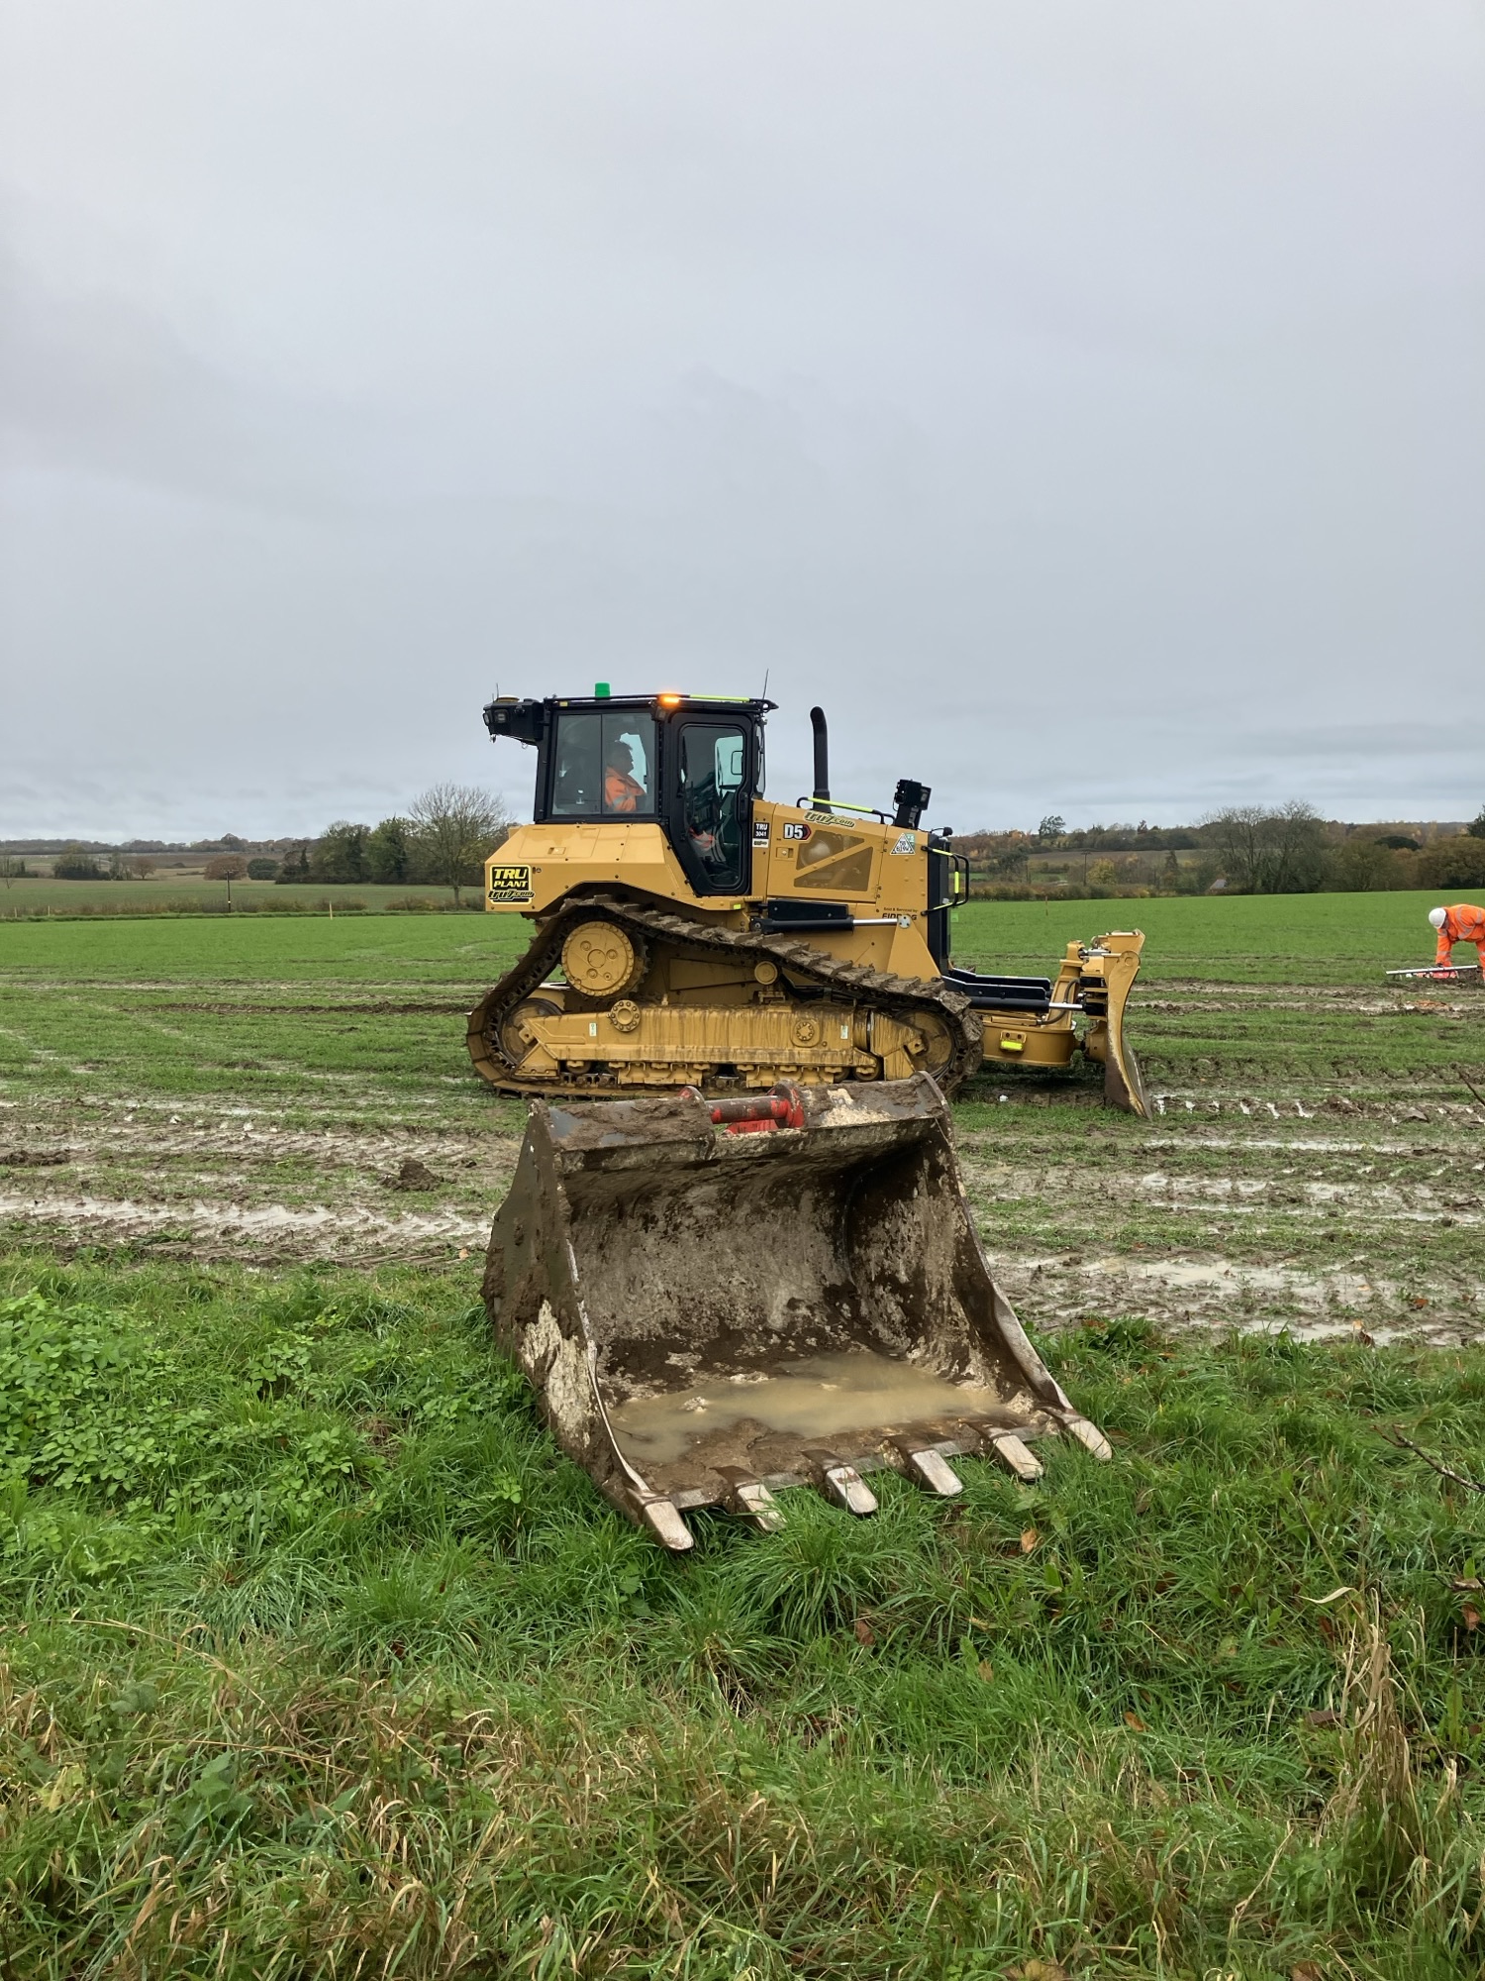
SLR - compound started at Trust Farm
Note: Work has just commenced, compound will be finished to same high standard as that at Littlemoor Road Phase 1

Slide 13
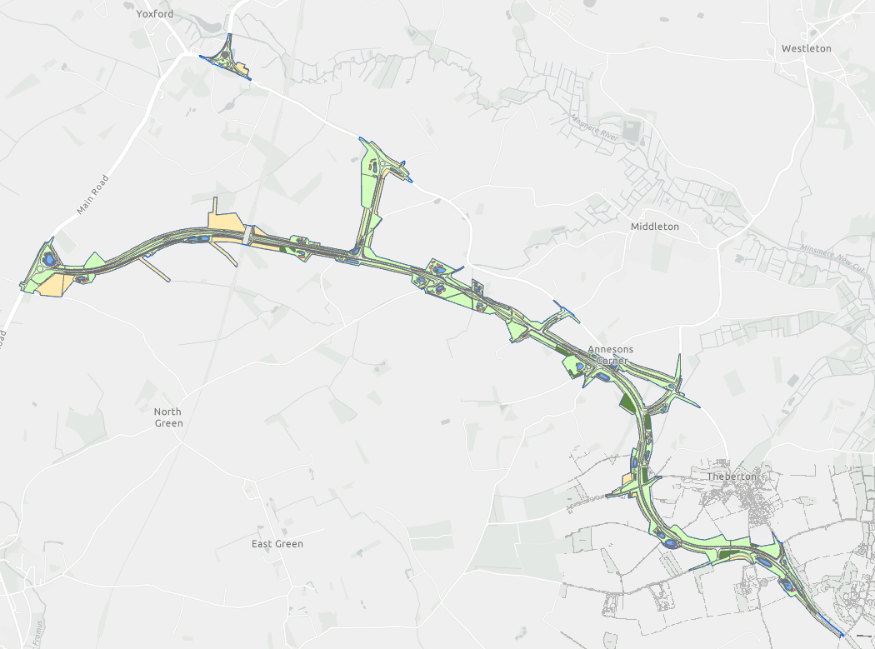
SLR - Main Works
Detail design complete and submitted for technical approval
Vegetation & ecology clearance ongoing
Construction Contract out to tender
Award for early 2025
Mobilisation Spring 2025
Utility works to be planned early 2025
Asset Details - Dash

Slide 14


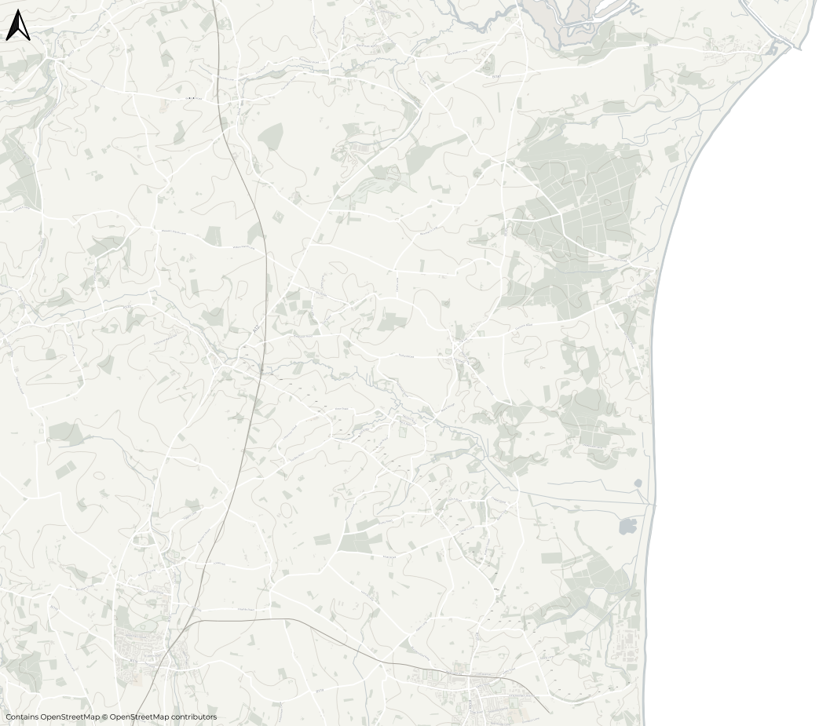








Blythburgh
Walberswick
Local Road Improvement Schemes – In Procurement
A144
A12
B1125
Darsham
Typical improvements
New and enhanced pedestrian footways and crossings
New road surfacing
Village gateways
Safety improvements and side road visibility
Westleton
Yoxford
Middleton Moor
B1122
A12
Eastbridge
B1119
Key road
Improvement scheme
Transport Working Group
Theberton
Saxmundham
Leiston
Sizewell
14
NOT PROTECTIVELY MARKED | © 2023 Sizewell C Limited. All rights Reserved.

Slide 15
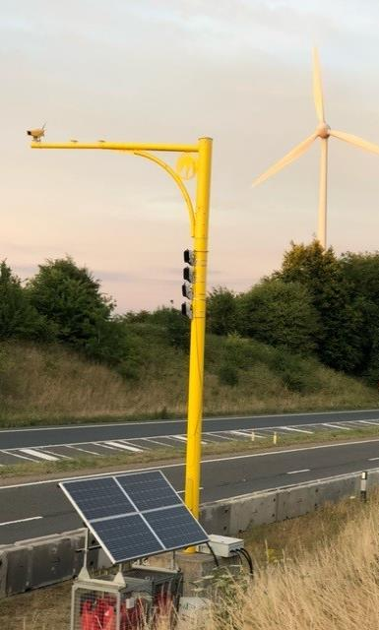

Average Speed Cameras Q1 2025
Blythburgh
Walberswick
Average speed camera enforcement
B1122 from Yoxford to Eastbridge Road / main site access
B1125 through Westleton
A12
B1125
A144
Darsham
Westleton
Dunwich
Yoxford
Middleton Moor
A12
B1122
Eastbridge
B1119
Theberton
© Copyright Jenoptik. All rights reserved.
Key road
Average Speed Camera Location
Saxmundham
Sizewell
Leiston
15

Slide 16


Thank you

